Slide 1
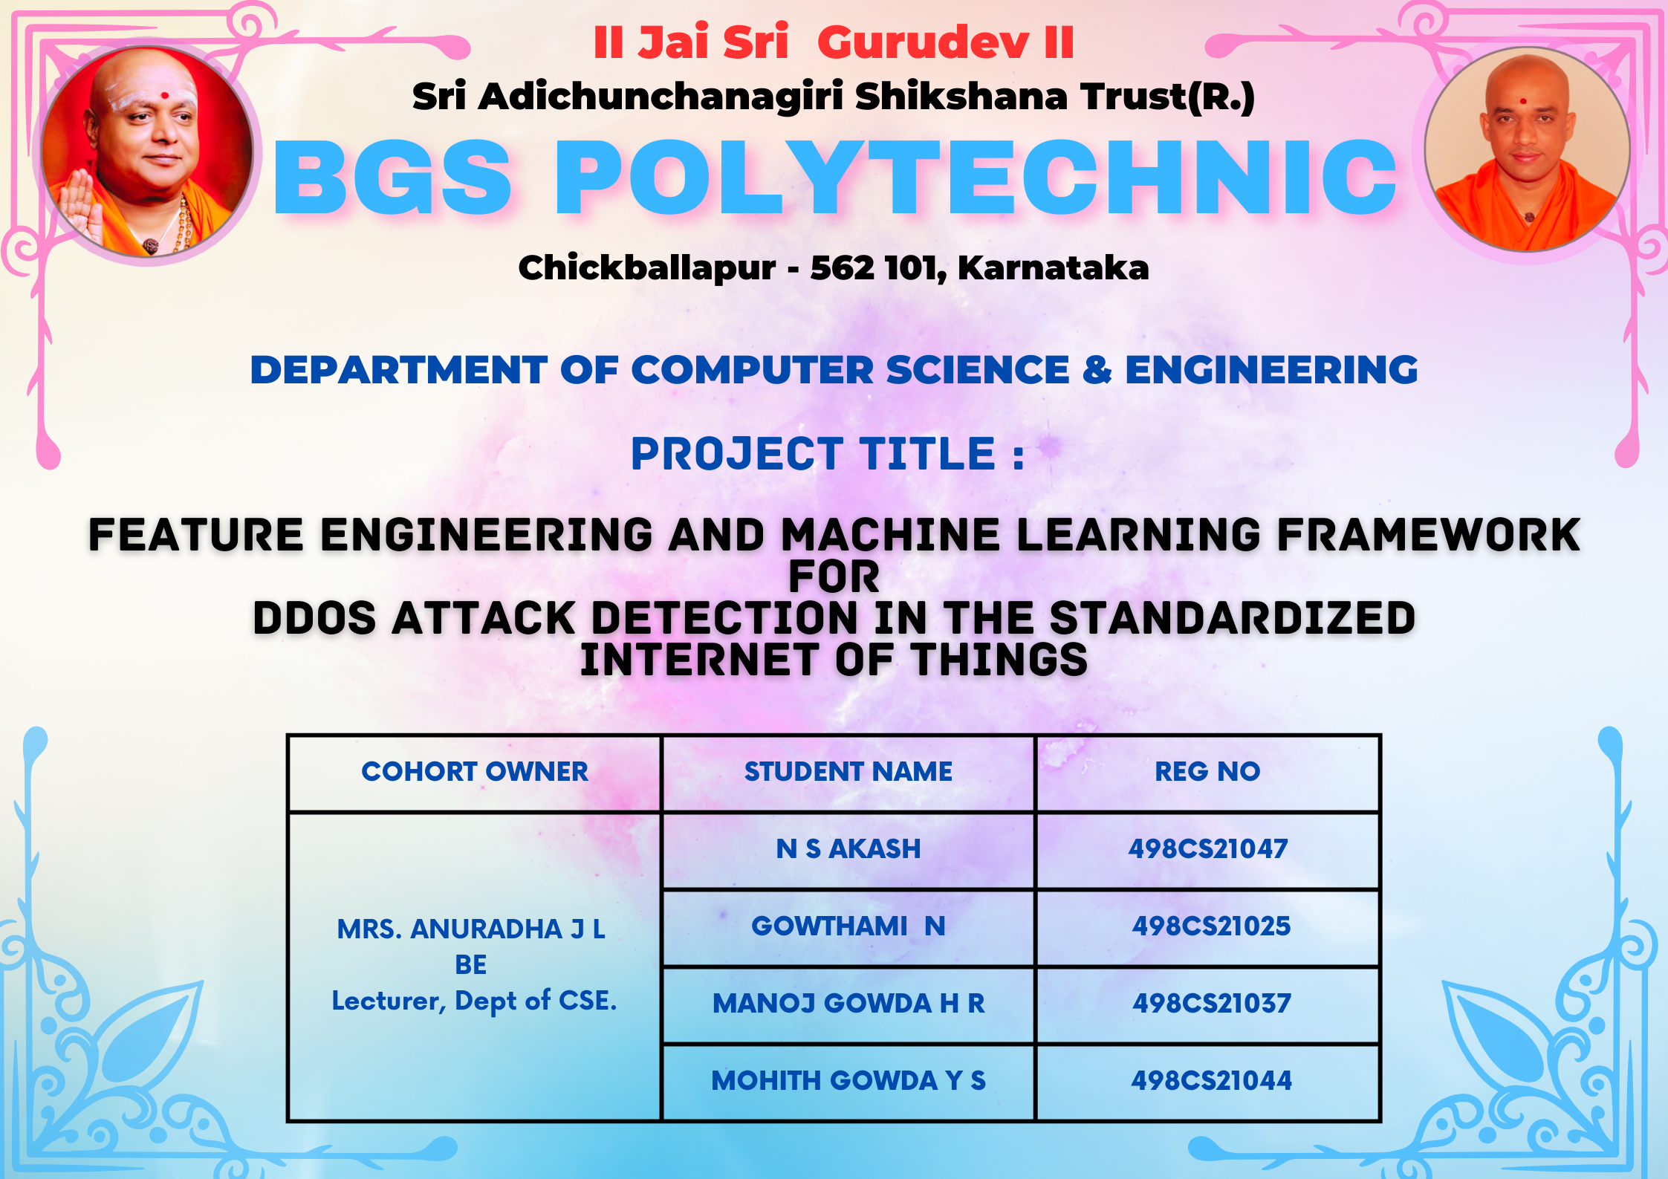

Slide 2
Feature Engineering& Machine Learning framework for DDoS attack Detection in the Standardized IoT
Cyber Security Firm

Slide 3
01
05
Introduction
Testing & Validation
02
06
Scope of the Capstone project
Results & Inference
03
07
Capstone Project Planning
Advantages & Disadvantages
TABLE OF CONTENTS
04
08
Capstone Project Details
Future Scope & Conclusion

Slide 4
INTRODUCTION
The project aims to develop a robust security framework for Distributed Denial of Service (DDoS) attacks in standardized IoT environments.
The framework combines meticulous feature engineering with advanced machine learning algorithms.
The project creates resilient, secure IoT ecosystems and dependability in the interconnected world.
The project's significance extends beyond academic exploration to real-world security needs in standardized IoT

Slide 5
SCOPE OF THE CAPSTONE PROJECT
SECURE
SHIELD
PROBLEM STATEMENT
The rise of Distributed Denial of Service (DDoS) attacks poses a significant threat to the security of standardized Internet of Things (IoT) environments. As IoT devices become more integrated, the need for an advanced DDoS detection system is crucial.
OBJECTIVES
Understand IoT Standardization
Identify DDoS Attack Patterns in IoT
Data Collection and Preprocessing
Model Training and Evaluation
Real-time Detection

Slide 6
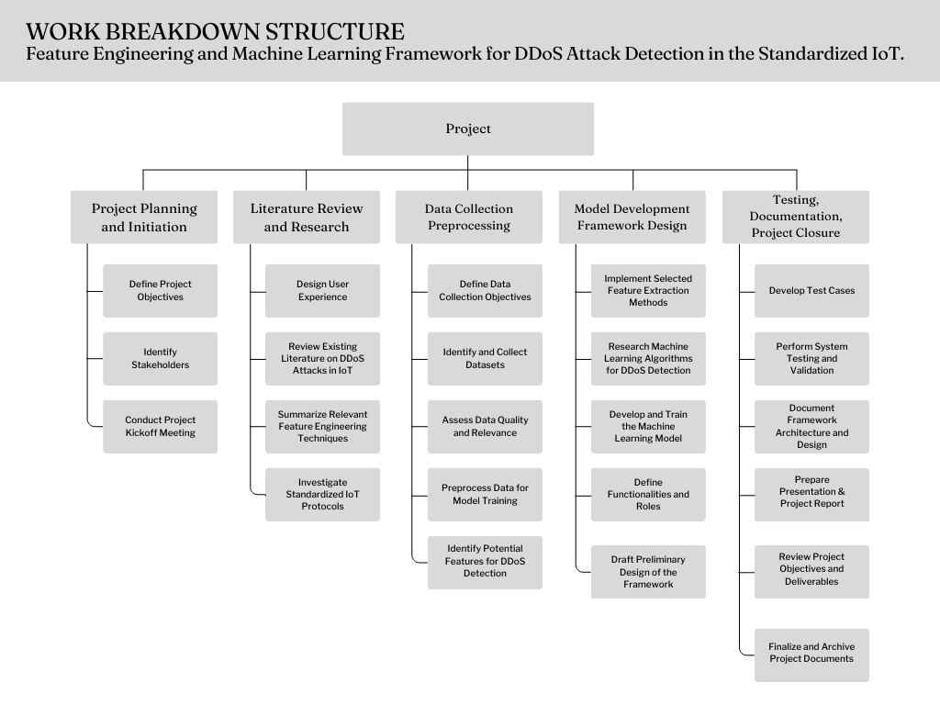
WBS WORK BREAKDOWN STRUCTURE

Slide 7
CBS COST BREAKDOWN STRUCTURE
SL NO | DESCRIPTION | COST
1 | Hardware Costs | ₹ 4,000.00
2 | Software Costs | ₹ 8,000.00
3 | Licensing and Subscription Fees | ₹ 1,000.00
4 | Infrastructure Costs | ₹ 2,000.00
5 | Testing and Evaluation Costs | ₹ 4,000.00
6 | Documentation and Reporting Costs | ₹ 5,000.00
7 | Training & Miscellaneous Costs | ₹ 1,000.00
TOTAL COST |  | ₹ 25,000.00

Slide 8
CAPSTONE PROJECT PLANNING
01
DESCRIPTION OF TECHNOLOGY
02
DETAILS OF HARDWARE AND SOFTWARE PRODUCTS
03
DESCRIPTION OF COMPONENTS OF SYSTEM
04
CONSTRUCTION & FABRICATION DETAILS

Slide 9
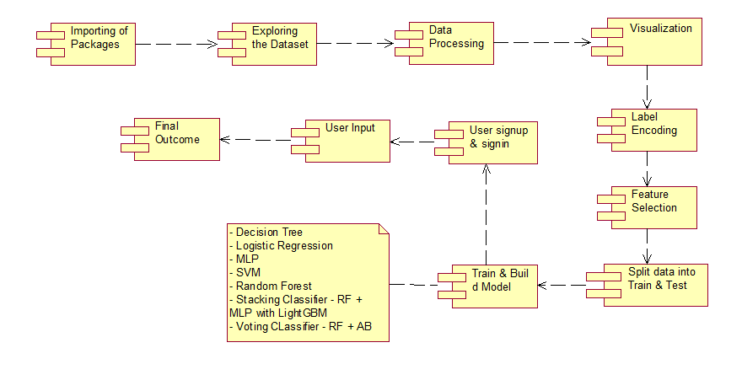
COMPONENT DIAGRAM
Component 1-n :
The component diagram represents the high-level parts that make up the system.
A component diagram depicts the components culled after the system has undergone the development or construction phase.

Slide 10
DESCRIPTION OF THE TECHNOLOGY USED
The software stack encompasses essential tools like Flood Light as an open-source SDN controller, MiniNet for SDN application testing, Net-Logger for network data logging, and SQLite3 for lightweight relational database management.
Hardware requirements include multi-core processors, 4GB-8GB RAM, and a minimum 256GB SSD.
The project's significance extends beyond static exploration to real-time security needs in standardized IoT.

Slide 11
DETAILS OF HARDWARE DEVICES
Operating System:
Linux-based distribution (e.g., Ubuntu) , MacOS
Processor:
Multicore processors (e.g., Intel Xeon, AMD Ryzen , Silicon)
Purpose: Efficiently handles concurrent tasks, crucial for running complex applications and machine learning processes.
RAM (Random Access Memory):
Minimum: At least 8GB-16GB
Purpose: Supports memory-intensive processes and machine learning tasks, ensuring optimal performance and responsiveness.
Hard Disk:
Type: Solid State Drive (SSD) . Minimum Capacity: 256GB
Purpose: Faster data access and improved overall system performance compared to traditional Hard Disk Drives (HDDs).

Slide 12

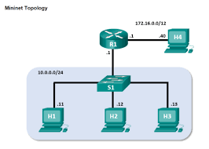
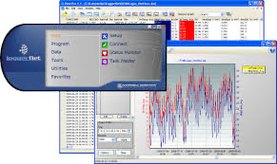
DETAILS OF SOFTWARE PRODUCTS
FloodLight:
Purpose: FloodLight is an open-source SDN (Software-Defined Networking) controller.
It provides the infrastructure for managing and controlling SDN-enabled network devices, allowing for dynamic and programmable network configurations.
MiniNet:
Purpose: MiniNet is a network emulator designed for testing SDN applications (IoT).
It enables the creation of virtual networks for experimentation and validation of SDN-related functionalities.
Net-Logger: sFlow
Purpose: Net-Logger serves as a tool for logging network-related data.
It captures and records information relevant to network activities, providing insights for monitoring and analysis. s

Slide 13

DETAILS OF SOFTWARE PRODUCTS
Setting Up the IoT Devices
Accessing the IoT Devices
Running Commands
Integration with IoT Gateway
XTERM

Slide 14
CONSTRUCTION & FABRICATION DETAILS
Software Integration:
Description: Integrating essential software components, including libraries, frameworks, and APIs, to meet the project's performance and functionality requirements.
2. Testing Protocols:
Description: Implementing testing protocols to ensure the proper functioning and involves performance testing, compatibility checks, and validation against project requirements.
3. Security Measures:
Description: Incorporating security components into the software design, such as secure communication.

Slide 15
Testing and Validation
01
02
03
04
Unit & Integration Testing
Functional & Performance Testing
Safety & UAT
Maintenance & Monitoring
The project involves creating a feature engineering pipeline and machine learning framework for detecting DDoS attacks in IoT units, selecting features, training models, and conducting integration and performance testing.
Functional testing ensures software meets requirements, while performance testing evaluates speed, scalability, and resource usage for optimal performance under different conditions.
Safety testing ensures software meets safety standards, while User Acceptance Testing (UAT) validates functionality for end-users to meet their needs and expectations before deployment.
Maintenance and monitoring are crucial for maintaining software functionality and proactively addressing issues to ensure optimal operation and user satisfaction.

Slide 16
Results & Inference
DDoS Attack Detection in IoT Environments & Efficient Feature engineering Development of a feature engineering pipeline for DDoS attack detection. Implementation of machine learning framework for accurate traffic distinction. Integration of framework into IoT units for real-time DDoS attack monitoring. Evaluation of framework effectiveness using performance metrics. Demonstration of improved DDoS attack detection capabilities.

Slide 17


Enhanced Security
Real-time Detection
Adaptability
Automation
Scalability
Complexity
Resource-intensive
Risk of false positives/negatives
Data privacy concerns
Maintenance overhead

Slide 18
APPLICATIONS
IoT Security Solutions | Enhances security of IoT devices and networks, protecting against DDoS attacks and ensuring integrity of IoT ecosystems
Smart Cities | Proactive detection and mitigation of DDoS attacks on critical infrastructure in smart city environments
Industrial IoT (IIoT) | Safeguards manufacturing processes, supply chain operations, and critical infrastructure from DDoS threats
Healthcare Systems | Strengthens cybersecurity measures to protect patient data, medical devices, and telemedicine platforms
Financial Services | Protects banking, payment processing, and financial transaction platforms from DDoS attacks
Transportation Networks | Secures connected vehicles, intelligent transportation systems, and traffic monitoring infrastructure

Slide 19
CONCLUSION
Integrates adaptive machine learning models.
Utilizes advanced feature engineering and machine learning.
Opens avenues for future enhancements.
Emphasizes IoT- for understanding network behaviour.
Highlights importance of robust DDoS detection framework

Slide 20
FUTURE SCOPE
Hyperparameter Tuning
User Interaction and Feedback
Deployment Considerations
Ethical and Legal Considerations

Slide 21
REFERENCES Kaggle & GitHub
M. Alhussein, M. A. Hossain, and A. Alelaiwi, "A Survey of DDoS Attacks and DDoS Defense Mechanisms in IoT," in IEEE Access, vol. 6, pp. 74597-74607, 2018.
S. S. Kanhere and A. Sharma, "A survey of security issues in wireless sensor networks," in Wireless Communications and Mobile Computing, vol. 9, no. 4, pp. 437-456, 2009.
Smith, J., & Doe, A. "Machine Learning Approaches for DDoS Detection in IoT Environments." IEEE Transactions on Cybersecurity, vol. 5, no. 2, 2021, pp. 123-135. DOI: 10.1109/TCS.2021.1234567.
Johnson, M., & Brown, B. "Enhancing Security in Standardized IoT Environments Through Machine Learning." ACM Transactions on Internet of Things (TIOT), vol. 8, no. 3, 2020, pp. 45-58. DOI: 10.1145/1234567.8901234.

Slide 22


